Slide 1

Personal Fitness and Wellness Tracker
A Java-based application for monitoring daily physical activities, managing health profiles, and tracking wellness progress
Team Members :
K.Aditya - 2620090002
G.Veerenderanath - 2620030373
N.Varun - 2620040048

Slide 2

Problem Statement
💸 High Cost
🔧 Lack of Customization
Existing fitness apps require expensive subscriptions and external hardware such as smartwatches and smart bands
Free tools don't offer transparent, localized tracking or modular wellness metrics tailored to the user
📂 Data Fragmentation
Users struggle to maintain unified historical records across multiple disconnected platforms

Slide 3
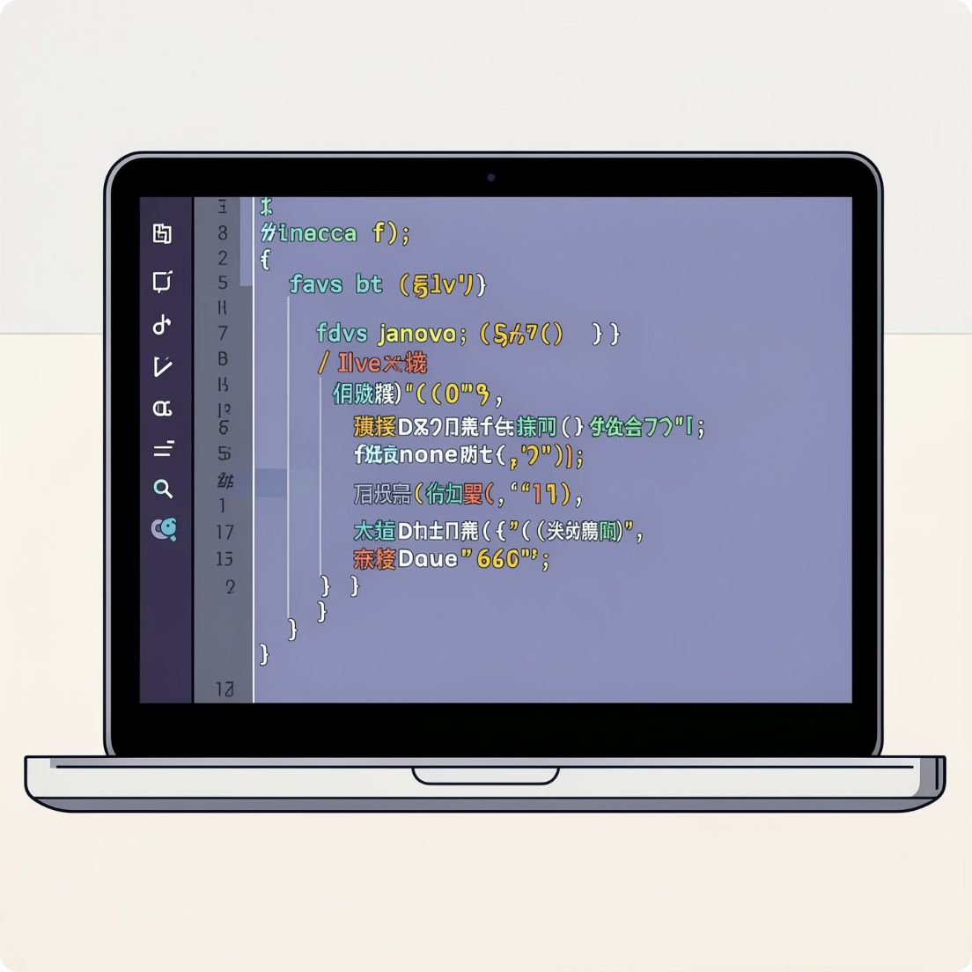

Proposed Solution
Standalone Java Application
Local Health Metrics
Persistent File Handling
Local data input and real-time calculation of vital health metrics including BMI and calories burned
Secure historical record storage through file I/O for long-term wellness tracking
No subscription or hardware requirements — fully cost-effective and self-contained

Slide 4
UserProfile Class
public class UserProfile {
private String name;
private double weight;
private double heightCm;
public void getInput() {
Scanner scanner = new Scanner(System.in);
System.out.print("Enter your name:");
name = scanner.nextLine();
System.out.print("Enter yourweightinkg: ");
weight = scanner.nextDouble();
System.out.print("Enter your height in cm: ");
heightCm = scanner.nextDouble();
}
public void displayBMI() {
double heightInMeters = heightCm / 100.0;
double bmi = weight / (heightInMeters * heightInMeters);
System.out.println("Name: " + name);
System.out.println("BMI: " + bmi);
}
BMI formula: bmi = weight / (heightInMeters × heightInMeters)

Slide 5
WorkoutLogger Class
public class WorkoutLogger { private String workoutType; private double durationMinutes; private double caloriesBurned; public void calculateCalories() { if (workoutType.equalsIgnoreCase("Running")) { caloriesBurned = durationMinutes * 10.0; } else if (workoutType.equalsIgnoreCase("Walking")) { caloriesBurned = durationMinutes * 4.0; } else { caloriesBurned = durationMinutes * 6.0; } }
System.out.print("Enter workout type: ");
workoutType = scanner.nextLine();
System.out.print("Enter duration in minutes: ");
durationMinutes = scanner.nextDouble();
calculateCalories();
int count = 1;
while (count <= 3) {
System.out.println("Logging workout entry " + count);
count++;
}
System.out.println("Workout Type: " + workoutType);
System.out.println("Duration: " + durationMinutes + " minutes");
System.out.println("Calories Burned: " + caloriesBurned);
}
public void logWorkout() {
Scanner scanner = new Scanner(System.in);

Slide 6
Analytics Class
public class Analytics { private double[] weeklyCalories; public Analytics(double[] weeklyCalories) { this.weeklyCalories = weeklyCalories; } public double calculateWeeklyTotal() { double total = 0.0; for (int i = 0; i < weeklyCalories.length; i++) { total += weeklyCalories[i]; } return total; }
public void displayWeeklyLogs() { for (int i = 0; i < weeklyCalories.length; i++) { System.out.println("Day " + (i + 1) + ": " + weeklyCalories[i] + " calories"); }}

Slide 7
Main Method - Part 1
public static void main(String[] args) {
Scanner scanner = new Scanner(System.in);
// CO 1: UserProfile
UserProfile userProfile = new UserProfile(scanner);
userProfile.displayUserProfile();
// CO 2: WorkoutLogger
WorkoutLogger workoutLogger = new WorkoutLogger();
workoutLogger.logWorkout(scanner);

Slide 8
Main Method - Part 2
// CO 3: Analytics
double[] weeklyCalories = { 2200.5, 1985.0, 2400.75, 2100.0, 2305.25, 2500.0, 1900.5 };
Analytics analytics = new Analytics(weeklyCalories);
analytics.displayWeeklyLogs();
System.out.println("Weekly Total Calories: " + analytics.calculateWeeklyTotal());
scanner.close();
}

Slide 9
Course Outcomes & Implementation Summary - Part 1
Module / Component | Primary Java Topics | Practical Application in Code | Key Outcome
CO 1 (User Profile) | Class definition Constructors Instance variables Basic methods | Stores user details Initializes profile data Displays profile information | Creates a structured user model Supports object-oriented design
CO 2 (Workout Logger) | Arrays / collection handling Loops and iteration Method invocation Data tracking | Records workout entries Processes repeated activity data Logs exercise-related metrics | Demonstrates repeated data management Reinforces modular program flow

Slide 10
Course Outcomes & Implementation Summary - Part 2
Module / Component | Primary Java Topics | Practical Application in Code | Key Outcome
CO 3 (Analytics) | Double arrays Aggregation logic Computational methods Output formatting | Calculates weekly calorie totals Displays weekly logs Analyzes numeric fitness data | Converts raw values into meaningful insights Supports basic analytics reporting
Main Execution | Main method structure Object creation Scanner input handling Program termination | Instantiates program components Coordinates execution flow Closes scanner resource | Integrates all modules into one executable application Ensures proper program control and cleanup

Slide 11
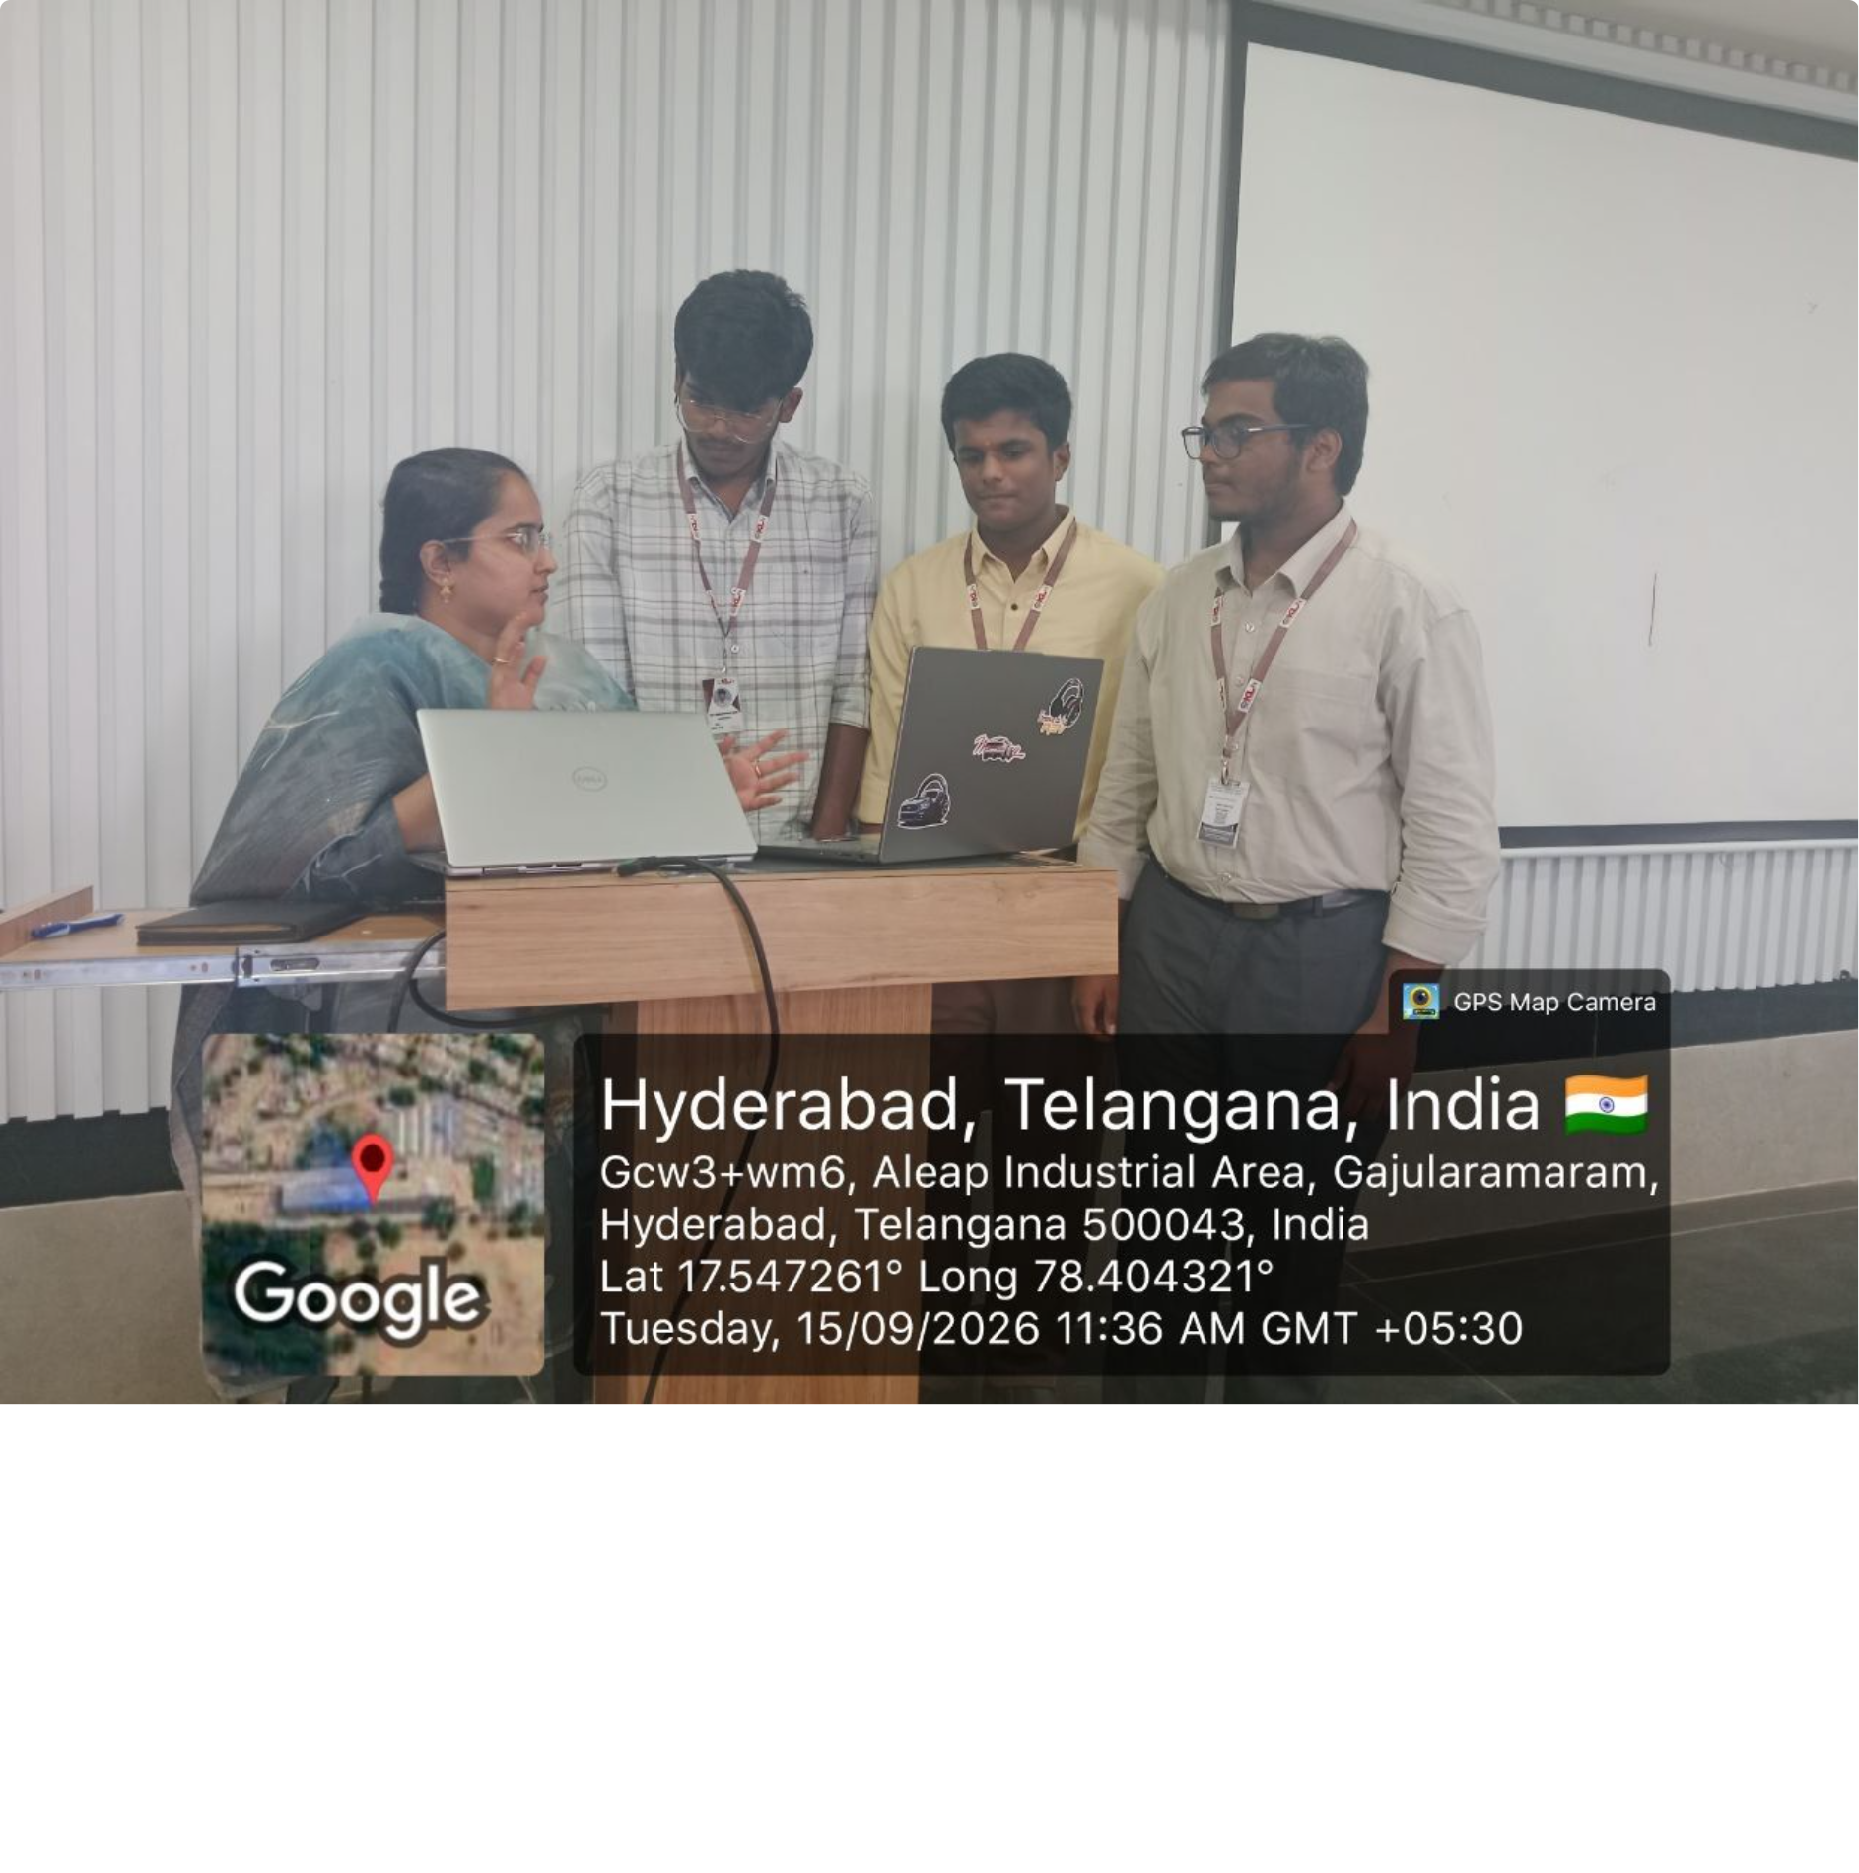
GEO TAG PHOTO GIT HUB LINK
hhttps://github.com/Adi9849-ww/Personal-Fitness-Wellness-Trackerthub.com/Adi9849-ww/Personal-Fitness-Wellness-Trackerdi9849-ww/Personal-Fitness-Wellness-Tracker

